Slide 1
Apache Camel – Training - Day-5
Documented By
Manikanta Jakkampudi

Slide 2
Agenda
Camel Component
CXF
Exception Handling
Need for design
Recoverable and irrecoverable errors
Camel way
Where Camel’s error handling applies
Camel Error handlers
Scope of Camel Error Handler
Handling Errors and Faults
Exception Policies
Using DoTry, DoCatch, and DoFinally
Using onException to handle Exceptions
Why the Exchange.getException() returns “null”?
Ignoring exceptions

Slide 3
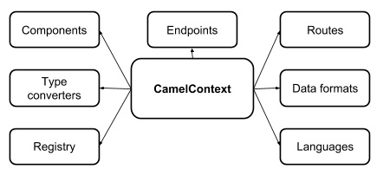
Camel Context
Camel Context

Slide 4
Camel Component - CXF
What is a webservice?
A webservice is nothing but the implementation of a specific business function and as an API on the network.
The API itself is defined using the Web Services Description Language (WSDL), specifying what operations you can call on a web service and what the input and output types are, among other things.
Messages are typically XML, formatted to comply with the Simple Object Access Protocol (SOAP) schema.
In addition, these messages are typically sent over HTTP.
SOAP based webservices typically works with a business contract/agreement.
What is CXF?
CXF is a popular open-source web services framework that supports many web services standards like JAX-WS (Java API for XML Web Services).
Following are two different approaches most commonly used in webservice development.
1. Contract-first approach
2. Code-first approach

Slide 5
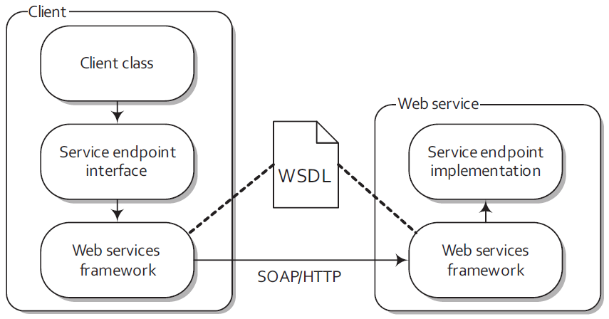
Camel Component – CXF …Continued
A client invokes a remote web service
over HTTP. To the client, it looks as
if it’s calling a Java method on the
Service endpoint interface (SEI).
Under the hood, this method invocation
passes through the web services
framework, across a network, and finally
calls into the service endpoint
implementation on the remote server.
Following are the five main elements
specified in the WSDL file and all WSDL files follow this same basic structure:
■ types - Data types used by the web service
■ message - Messages used by the web service
■ portType - Interface name and operation performed by the web service
■ binding - Transport type and message encoding used by the web service
■ service - Web service definition, which specifies the binding to use as well as the network address to use

Slide 6
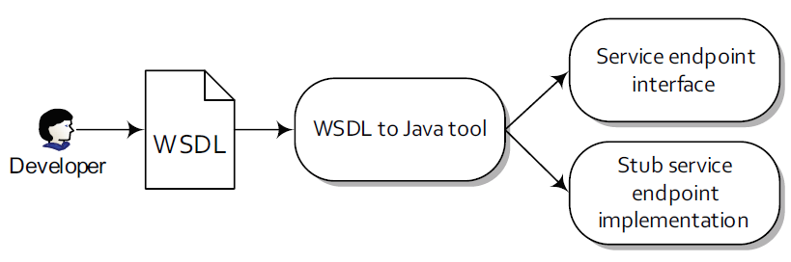
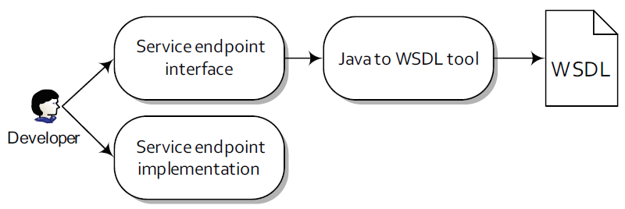
Camel Component – CXF …Continued
Contract-first approach:
Code-first approach:

Slide 7
Camel Component – CXF …Continued
Configuring CXF:
There are two main ways to configure a CXF component URI:
1. by referencing a bean containing the configuration or
cxf:bean:beanName
2. by configuring it within the URI.
cxf://anAddress[?options]
Common URI options used to configure the CXF component Option Default:
Option | Default Value | Description
wsdlURL | Retrieved from the endpoint Address | Specifies the location of the WSDL contract file.
serviceClass | null | Specifies the name of the service endpoint interface (SEI).
serviceName | Obtained from the WSDL | Specifies the service to use. The format is a qualified name (QName) that has a namespace and name like {http:// order.camelinaction}OrderEndpointService.
portName | Obtained from the WSDL | Specifies the port to use. The format is a qualified name (QName) that has a namespace and name like {http:// order.camelinaction}OrderService. Note that if there is only one port in a WSDL, Camel will choose this as the default port. If there is more than one port defined per service, you need to set the portName property.
dataFormat | POJO | Sets the data format type that CXF uses for its messages. The possible values are POJO, PAYLOAD, and MESSAGE.

Slide 8
Camel Component – CXF …Continued
Configure using a CXF Endpoint Bean:
cxf:bean:orderEndpoint
<beans xmlns=http://www.springframework.org/schema/beans xmlns:xsi=http://www.w3.org/2001/XMLSchema-instance
xmlns:cxf=http://camel.apache.org/schema/cxf
xsi:schemaLocation=“http://www.springframework.org/schema/beans
http://www.springframework.org/schema/beans/spring-beans-3.0.xsd
http://camel.apache.org/schema/cxf
http://camel.apache.org/schema/cxf/camel-cxf.xsd">
<import resource="classpath:META-INF/cxf/cxf.xml"/>
<import resource="classpath:META-INF/cxf/cxf-extension-soap.xml"/>
<import resource="classpath:META-INF/cxf/cxf-extension-http-jetty.xml"/>
<cxf:cxfEndpoint
id="orderEndpoint"
address="http://localhost:9000/order/"
serviceClass=“com.sn.order.OrderEndpoint“
serviceName=“OrderEndpointService”
portName=“OrderService”
wsdlURL="wsdl/order.wsdl"/>
</beans>

Slide 9
Camel Component – CXF …Continued
Configure Camel CXF Producer:
A producer in Camel calls a remote web service
to("cxf:bean:orderEndpoint")
Configure Camel CXF Consumer:
Consumers are a little more interesting, as they expose an entire route to the world as a web service.
from("cxf:bean:orderEndpoint")
Maven Dependencies:
<dependency>
<groupId>org.apache.camel</groupId>
<artifactId>camel-cxf</artifactId>
<version>X.X.X</version>
</dependency>
Dependency for CXF Tarnsport:
<dependency>
<groupId>org.apache.cxf</groupId>
<artifactId>cxf-rt-transports-http-jetty</artifactId>
<version>2.2.10</version>
</dependency>

Slide 10
Camel Component – CXF …Continued
Sample Camel-CXF Producer route: (consume other webservice in Camel)
<route>
<from uri="direct:startOrder" />
<setHeader headerName="operationName">
<constant>order</constant>
</setHeader>
<to uri="cxf:bean:orderEndpoint"/>
</route>
Sample Camel-CXF Consumer Route: (exposing webservice from Camel)
<route>
<from uri="cxf:bean:orderEndpoint" />
<to uri="seda:incomingOrders" />
<transform>
<constant>OK</constant>
</transform>
</route>

Slide 11
Camel Component – CXF …Continued
A sample Maven configuration for using CXF wsdl2java tool for code generation:
<plugin>
<groupId>org.apache.cxf</groupId>
<artifactId>cxf-codegen-plugin</artifactId>
<version>2.2.10</version>
<executions>
<execution>
<id>generate-sources</id>
<phase>generate-sources</phase>
<configuration>
<sourceRoot>${basedir}/target/generated/src/main/java</sourceRoot>
<wsdlOptions>
<wsdlOption>
<wsdl>${basedir}/src/main/resources/wsdl/order.wsdl</wsdl>
<extraargs>
<extraarg>-impl</extraarg>
</extraargs>
</wsdlOption>
</wsdlOptions>
</configuration>
<goals>
<goal>wsdl2java</goal>
</goals>
</execution>
</executions>
</plugin>

Slide 12
Camel Exception handling
Need for design:
Writing applications that integrate disparate systems are a challenge when it comes to handling unexpected events.
In a single system that you fully control, you can handle these events and recover. But systems that are integrated over the network have additional risks: the network connection could be broken, a remote system might not respond in a timely manner, or it might even fail for no apparent reason.
Even on your local server, unexpected events can occur, such as the server’s disk filling up or the server running out of memory. Regardless of which errors occur, your application should be prepared to handle them.
Recoverable and irrecoverable errors:
A recoverable error, on the other hand, is a temporary error that might not cause a problem on the next attempt. A good example of such an error is a problem with the network connection resulting in a java.io.IOException. On a subsequent attempt, the network issue could be resolved and your application could continue to operate.
An irrecoverable error is an error that remains an error now matter how many times you try to perform the same action again. In the integration space, that could mean trying to access a database table that doesn’t exist, which would cause the JDBC driver to throw an SQLException.

Slide 13
Camel Exception handling …Continued
Camel Way:
In Camel, a recoverable error is represented as a plain Throwable or Exception that can be set or accessed from org.apache.camel.Exchange using one of the following two methods:
void setException(Throwable cause);
Exception getException();
Exceptions are represented as recoverable errors.
An irrecoverable error is represented as a message with a fault flag that can be set or accessed from org.apache.camel.Exchange. For example, to set "Unknown customer“ as a fault message, you would do the following:
Message msg = Exchange.getOut();
msg.setFault(true);
msg.setBody("Unknown customer");
Fault messages are represented as irrecoverable errors.

Slide 14
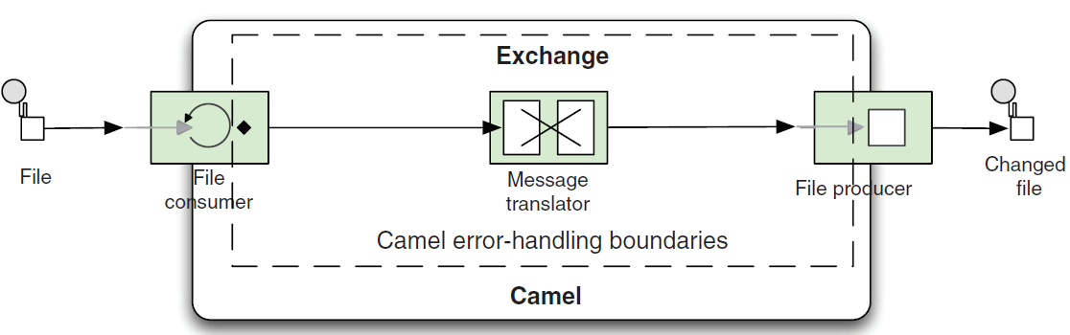
Camel Exception handling …Continued
Where Camel’s error handling applies
Camel’s error handling doesn’t apply everywhere.
Camel’s error handling only applies within the lifecycle of an exchange.

Slide 15
Camel Exception handling …Continued
Camel Error handlers
Scope of Camel Error Handler:
Scopes can be used to define error handlers at different levels.
Camel supports two scopes:
a context scope and
a route scope.
Error Handler | Description
DefaultErrorHandler | This is the default error handler that’s automatically enabled, in case no other has been configured.
DeadLetterChannel | This error handler implements the Dead Letter Channel EIP.
TransactionErrorHandler | This is a transaction-aware error handler extending the default error handler.
NoErrorHandler | This handler is used to disable error handling altogether.
LoggingErrorHandler | This error handler just logs the exception.

Slide 16
Camel Exception handling …Continued
Camel Error handlers
The default error handler is configured with these settings:
■ No redelivery
■ Exceptions are propagated back to the caller
The DeadLetterChannel error handler is similar to the default error handler except for the following differences:
■ The dead letter channel is the only error handler that supports moving failed messages to a dedicated error queue, which is known as the dead letter queue.
■ Unlike the default error handler, the dead letter channel will, by default, handle exceptions and move the failed messages to the dead letter queue.
■ The dead letter channel supports using the original input message when a message is moved to the dead letter queue.
errorHandler(deadLetterChannel("jms:queue:dead").useOriginalMessage())
Exception e = exchange.getProperty(Exchange.CAUSED_EXCEPTION, Exception.class);

Slide 17
Camel Exception handling …Continued
Handling Errors:
errorHandler(defaultErrorHandler() ← Context level
.maximumRedeliveries(2)
.redeliveryDelay(1000)
.retryAttemptedLogLevel(LoggingLevel.WARN));
from("file://target/orders?delay=10000")
.beanRef("orderService", "toCsv")
.to("mock:file")
.to("seda:queue.inbox");
from("seda:queue.inbox")
.errorHandler(deadLetterChannel(“amq:queue:DLC") ← Route level
.maximumRedeliveries(5).retryAttemptedLogLevel(LoggingLevel.INFO)
.redeliveryDelay(250).backOffMultiplier(2))
.beanRef("orderService", "validate")
.beanRef("orderService", "enrich")
.to(“amq:queue.order");

Slide 18
Camel Exception handling …Continued
Handling Faults:
To enable fault handling on the CamelContext (context scope), you simply do this:
getContext().setHandleFault(true);
To enable it on a per route basis (route scope), do this:
from("seda:queue.inbox").handleFault()
.beanRef("orderService", "toSoap")
.to("mock:queue.order");
Once fault handling is enabled, the Camel errors handlers will recognize the SOAP faults and react. Under the hood, the SOAP fault is converted into an Exception with the help of an interceptor.

Slide 19
Camel Exception handling …Continued
Exception policies:
Exception policies are used to intercept and handle specific exceptions in particular ways.
In Camel, exception policies are specified with the onException method in the route.
Selection criteria for onException:
Camel will traverse the hierarchy from the bottom up to the root searching for an onException that matches the exception.
If no suitable policy can be found, Camel relies on the configured error handler settings.
Suppose you have these three onException definitions, each having a different redelivery policy and the exception thrown is java.io.FileNotFoundException:
onException(ConnectException.class)
.maximumRedeliveries(5);
onException(IOException.class)
.maximumRedeliveries(3).redeliveryDelay(1000);
onException(Exception.class)
.maximumRedeliveries(1).redeliveryDelay(5000);

Slide 20
Camel Exception handling …Continued
Multiple Exceptions per onException:
Its possible to define multiple exceptions in the same onException:
onException(XPathException.class, TransformerException.class)
.to("log:xml?level=WARN");
onException(IOException.class, SQLException.class, JMSException.class)
.maximumRedeliveries(5).redeliveryDelay(3000);
Another scenario:
errorHandler(defaultErrorHandler().maximumRedeliveries(3).delay(3000));
onException(IOException.class).maximumRedeliveries(5);
from("jetty:http://0.0.0.0/orderservice")
.to("mina:tcp://erp.rider.com:4444?textline=true")
.beanRef("orderBean", "prepareReply");

Slide 21
Camel Exception handling …Continued
Using DoTry, DoCatch, and DoFinally:
public void configure() {
from("mina:tcp://0.0.0.0:4444?textline=true")
.doTry()
.process(new ValidateOrderId())
.to("jms:queue:order.status")
.process(new GenerateResponse());
.doCatch(JmsException.class)
.process(new GenerateFailureResponse())
.end();
}
Using onException to handle Exceptions:
OnException doesn’t handle exceptions by default, need to use handled(true) to indicate that onException should handle the exception.
This is important to remember, because it must be specified when you want to handle the exception.
Handling an exception will not continue routing from the point where the exception was thrown. Camel will break out of the route and continue routing on the onException.
If you want to ignore the exception and continue routing, you must use continued(true)

Slide 22
Camel Exception handling …Continued
Why the Exchange.getException() returns “null”?
When an exception marked onException to handle(=true) the exception;
Then Camel moves the exception from the Exchange to the Exchange.EXCEPTION_CAUGHT property.
So calling Exchange.getException will return null.
Properties on the Exchange related to error handling
Exchange.EXCEPTION_CAUGHT
Exchange.FAILURE_ENDPOINT
Exchange.ERRORHANDLER_HANDLED
Exchange.FAILURE_HANDLED
Ignoring exceptions:
Handling an exception means that Camel will break out of the route.
But there are times when all you want is to catch the exception and continue routing.
This is possible to do in Camel using continued.
All you have to do is to use continued(true) instead of handled(true).
onException(JmsException.class).handled(true)
.process(new GenerateFailueResponse());
onException(ValidationException.class).continued(true);

Slide 23
Thank You

